Slide 1


Employee Retention Strategies
August 31, 2021

Slide 2
You can rely on our expertise in Employee Benefits to help solve your most complex challenges. Customers are at the heart of everything we do, and we’re focused on improving the customer experience – and your results.
Our expertise runs deep | Our service model is unmatched | We put people first to do claims right
What sets us apart: | How we deliver for you: | Why it matters:
Employee benefits are what we do Our people know their stuff and innovate We believe in partnership | Single point of contact to support you Deep bench of experts You can trust us to follow through and get it right | We are committed to doing the right thing Taking care of claimants is the most important thing we do
The Results:
You’ll work with a consultative team who will help you provide tailored, competitive benefits Our people-first approach leads to happier, healthier and more productive employees

Slide 3
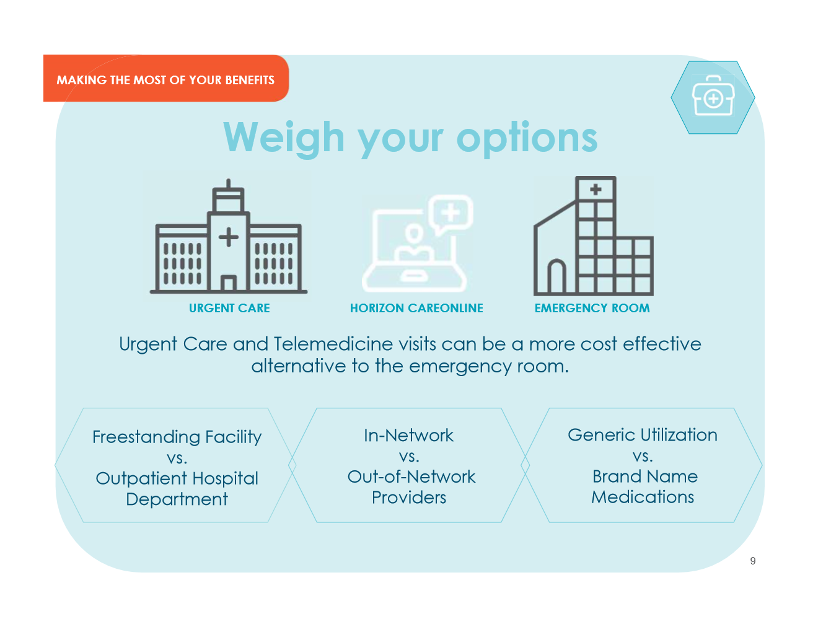

Slide 4


Dental Insurance
Ameritas dental network
Flexible plans
Streamlined enrollment and implementation process
Notes:
.

Slide 5

Vision Insurance
Two nationwide networks: VSP & EyeMed
‭Flexible options, including those
for small businesses
‭Coverage for spouses and children
‭Dual or Triple Choice coverage²
¹ Complete COBRA administration available for groups with 20 or more lives
² Only available for groups with 20–1,000 lives

Slide 6



Customized Enrollment Materials
Custom enrollment booklets
  Benefit Summaries
  Forms
Posters
Postcards
Endorsement letters
Email campaigns

Slide 7
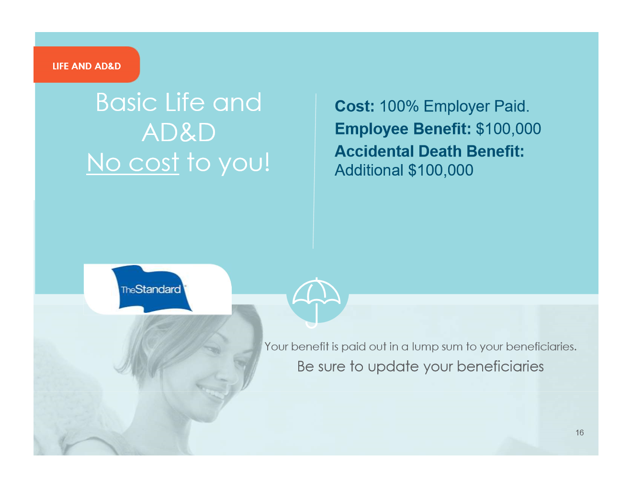
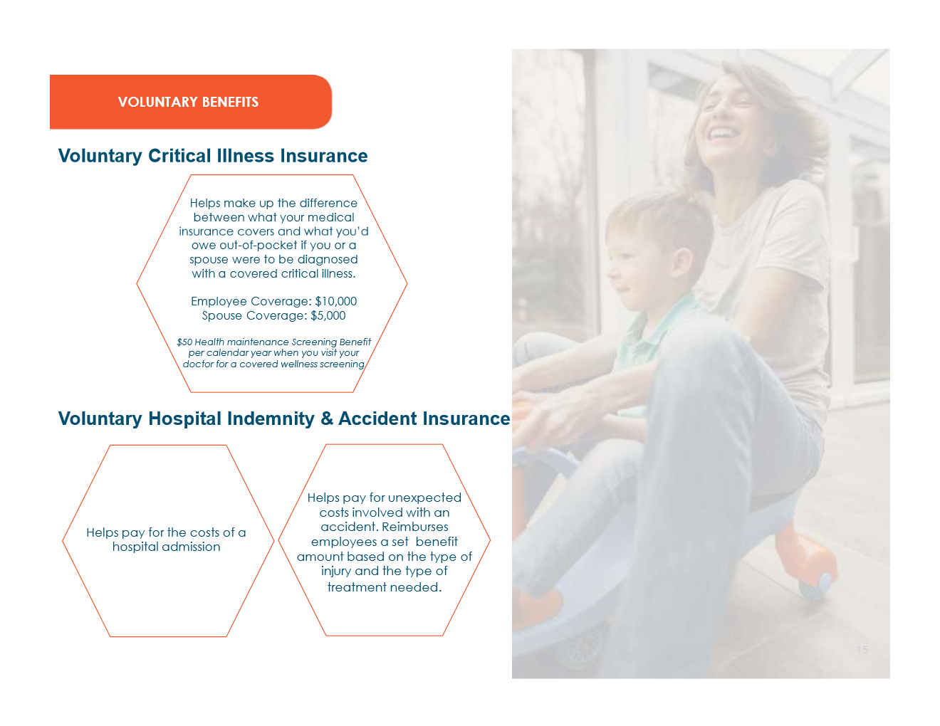

Slide 9
Today’s Economy
U.S. Workers underestimate their risk of a disability¹
Just under 1 in 4 are not able to pay all of their current month’s
bills in full²
Life expectancy and mortality outlook varies³
U.S. incomes are growing, but slowly¹
Large regional income disparities and growing inequity¹
What does this mean?
Increased demand for disability insurance⁴

Slide 10
1 in 4 Americans are not able to pay all of their current month’s bills in full*
The Current Reality
* “Report on the Economic Well-Being of U.S. Households in 2016,” the U.S. Federal Reserve System Board of Governors, May 2017, federalreserve.gov/publications/files/2016-report-economic-well-being-us-households-201705.pdf
Notes:
.

Slide 11


Short Term
Disability Insurance
Short Term
Disability Insurance
Weekly benefits
Reasonable Accommodation Expense Benefit
Return-to-Work Incentives
No pre-existing condition exclusions for coverage amounts under $2,500 per week
Weekly benefits
Reasonable Accommodation Expense Benefit
Return-to-Work Incentives
No pre-existing condition exclusions for coverage amounts under $2,500 per week

Slide 12

Long Term
Disability Insurance
Monthly benefits
Employee Assistance Program*
Return-to-Work Incentives
Enhanced product option
Optional Lifetime Security Benefit
Optional Assisted Living Benefit
* EAP is provided through an arrangement with a service provider that is
not affiliated with The Standard.

Slide 13
Guarantee Standard Issue (GSI) Policies
Available with 7 or more lives on employer paid basis
Individual Disability Insurance contracts on a group platform
Combats reverse discrimination for higher earners
Fully portable at same pricing, annual salary increase allowed
Combined claims intake for Group LTD and GSI

Slide 14

Life Insurance
Portability & conversion included
Accelerated Benefit
Waiver of Premium
Travel Assistance
Life Services Toolkit

Slide 15






Worksite Products
Group Whole
Life Insurance
Executive Group Life Insurance
Executive Disability Income Insurance
Group Universal
Life Insurance
Group Critical
Illness Insurance
Group Accident
Insurance
Not all products and services are approved at all broker/dealers.
FOR FINANCIAL PROFESSIONAL USE ONLY. NOT FOR USE WITH THE PUBLIC.
Notes:
FOR ALL PLATFORMS
EXCLUDE EDWARD JONES AND BANK OF AMERICA/MERRILL LYNCH
We’ve earned our leading reputation by developing a comprehensive portfolio of products and services. From start-ups to billion dollar plans, our variety of product offerings can support entities of all sizes.
Plan sponsors trust us to provide industry-leading retirement plan, investment and voluntary benefit solutions to help drive better financial outcomes.
(REVIEW SLIDE CONTENT)

Slide 16
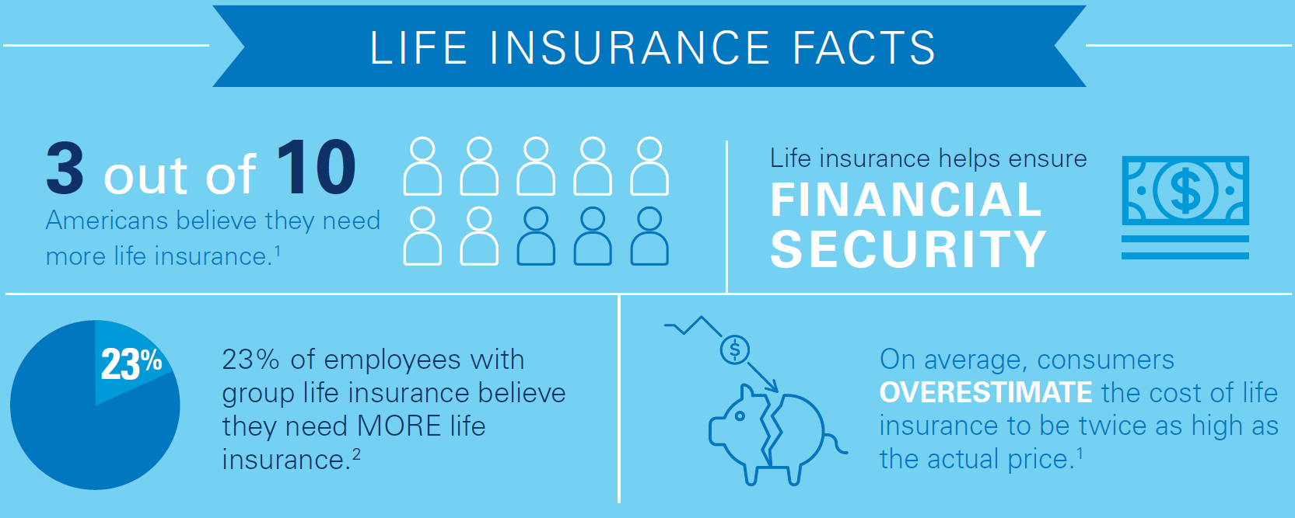
Group Life Insurance
Worksite Employer Positioning
Group term life insurance is a foundation of many employee
benefit offerings. Unfortunately, it is not a permanent solution.
LIMRA and LIFE Foundation, 2015 Insurance Barometer Study.
LIMRA and LIFE Foundation, 2016 Insurance Barometer Study.
Notes:
Permanent Life Insurance can be the foundation of long term protection for employees. Worksite permanent life can help employees navigate some of the myths about life insurance: (READ STATS)
Group Term Life Insurance can be a great employer provided benefit, but is often only 1x-3x salary and only available while the employee is working for the employer
Permanent Life Insurance is protection that can follow the employee throughout their life as long as the coverage is kept in force.

Slide 17

Our Enrollment Decision Support Tool*
Optimized for Today’s Employees
Informative videos and benefit claim examples - Each short video explains benefits using everyday language
Calculators - To help employees determine their Life and Disability needs, calculators can estimate the right level of protection
Mobile-friendly design with touch screen enhancements - For easy access, digital content is optimized to fit any screen size
Self-paced learning - Benefit information is available for any learning pace
* DST (Decision Support Tool) is available to groups with more than 100 lives.

Slide 18

Questions?

Slide 19
Information Needed for Group Solutions:
Current Billing Statement –
if your company has a plan.
Census -
We can provide a template.
Policy and/or Certificates
GoldBookNS.com
480.739.3400

Slide 20
Thank You for Attending.
We look forward to partnering with you!

