Slide 1
Federal Affairs Update
Arizona Annual Meeting
August 2021
Rob Underwood
President
Energy Marketers of America

Slide 2
Energy Marketers of America Overview
EMA is comprised of 47 independent energy marketer trade associations.
The origins of EMA date back to 1909:
1909 -- Independent Petroleum Marketers Association of the United States.
1948 -- that group became the National Oil Jobbers Council (NOJC).
1984 -- NOJC changed its name to PMAA.
2020 – Now called the Energy Marketers of America (EMA).
Every marketer in this room is an EMA member through APMA.
Jason Davis, Arizona Fuel Distributors, is APMA’s EMA Director.

Slide 3
REGIONS
COMMITTEES
Divisions within Executive Committee:
Lubricants
Brands
Disaster Response
Northeast
Southeast
North Central
South Central
West
Motor Fuels
Convenience Store
Heating Fuels
BOARD OF DIRECTORS
Executive
Committee
CHAIR
APPOINTED
Association
Executives
Conference
Budget
Audit
Investments & Reserves
EMA
President
Task Forces
(UST)
EMA
Staff

Slide 4
Congressional Update
Senate: GOP 50 – Dems 50.
Dems unlikely to eliminate the Filibuster, pack the courts or pass progressive legislative policies, such as the Green New Deal (“GND”), despite what you read in the headlines.
McConnell – “Scorched Earth” threat. Slow the Senate down to a standstill.
Senate moderates are stronger than ever. “Roads and Bridges” Infrastructurebill passed Senate.
Manchin (D-WV) said he opposes eliminating the filibuster, the GND. Sinema (D-AZ) and Manchin hold the keys to what Democrats can accomplish via reconciliation.
Even though Dems flipped Georgia Senate seats to secure the Senate majority, they face an uphill climb to repeal the entire GOP tax law**, impose drastic tax increases, or pass a carbon tax/federal cap & trade.
Dems do not want to be blamed for raising gas taxes.
Dems Control House but by smaller margin: 220-212. 3 vacancies. Dems can only lose 4 votes. Focus on Dems in Trump Districts and blue dog dems.

Slide 5
What does EMA do for you?
EMA continued to lead the way in disaster response efforts by:
Reforming the waiver process
Clearing regulatory hurdles
Minimizing delays at weigh stations and securing thousands of free masks from the government.
Medical card renewal waiver/HAZMAT license renewal and testing waiver.
Past EMA wins include:
Most recent: Expanding the maximum distance short-haul drivers may travel each day!!
EMA’s low liquid level integrity test as an alternative method for containment sump testing (over $500 million in savings every three years)
Defeated a wetlines and side underride rails mandates. ($120 million in savings)
Opposed 10-micron filter mandate ($200 million in savings)
SPCC Parked truck rule – EMA requested cargo tank vehicles parked overnight at bulk facilities be exempted from sized secondary containment requirements.
SBA Small Business size threshold changed from $11 million in gross receipts to 100 employees.
Biodiesel Blender’s Tax Credit renewed and provided compliance information to claim the credit.

Slide 6
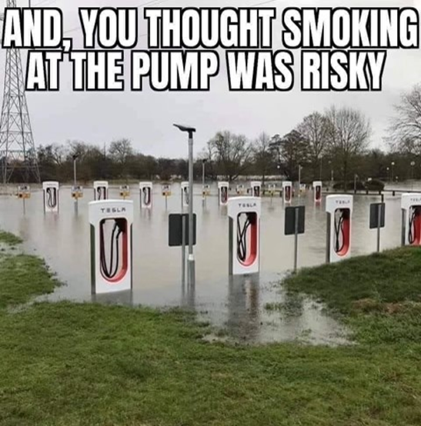

Slide 7
Far Left Policy Hurdles
Biden’s agenda will take years to implement with no guarantee that these efforts will be successful.
Regulatory Hurdles include:
Administrative Procedure Act
Republican led states likely to challenge the Biden Administration’s final rules in court.
Trump appointed federal judges could stymie much of Biden’s agenda. “no vacancy left unfilled” – McConnell
Legislative Hurdles include:
If going the reconciliation route (50 votes), it only takes one Senator to tank the whole thing. Think Senate moderates
Significant differences on how to pay for it. Deficit spend or increase taxes? Limitations with budget reconciliation
Biggest question… How far will Dems go to change certain GOP tax law provisions through reconciliation… will Dems tweak certain GOP tax law provisions through reconciliation? (increase C corp tax, cap gains, death tax, step up in basis, truck taxes?) Senator Kyrsten Sinema (D-AZ) has already raised concerns over the $3.5 trillion price tag so it remains uncertain how the House and Senate will move forward on a reconciliation package. It also remains uncertain how the House will treat the Senate’s BIB. Speaker Pelosi has said that the House will not consider the BIB without also advancing a reconciliation package.
Real World Hurdles include:
Electrification has already put two environmental constituencies at odds.... Conservationists who oppose using federal land needed to mine lithium and copper vs Green Energy who need the land.
Unless the Biden Administration changes course, the future of mining will likely depend on China.

Slide 8
Motor Fuels Issues
Surface Transportation & Infrastructure
Small Businesses Should be Supported with a minimum of 1/3rd of Alternative Energy Grant Program funds and be energy/fuel neutral
Utilities and non-utilities, including private businesses, should be on a level playing field when building Alternative Energy Infrastructure
Support the DRIVE-Safe Act
Oppose Interstate Rest Area Commercialization
EV Tax Credit Concerns
RFS Reform
E15 Compatibility Issues
RINs market leading to an unlevel playing field in the marketplace.
Current E15 branding and labeling on price signs and dispensers using brands such as “unleaded plus,” “unleaded 88,” and “eblend,” are confusing motorists.

Slide 9
RFS Reform
D4 & D6 RINs for RFS compliance continue to trade higher after Biden victory. Highest levels since 2014.
EMA requesting urgent action to reduce the corn ethanol mandate to 9.7 percent of projected gasoline demand to address the current E15 crisis.
Retrofit costs for E15 compatible equipment are expensive and could place small business fuel marketers out of business.
Biden Administration under significant pressure to provide relief from labor union leaders and Senators from his home state of Delaware. SCOTUS recent decision likely to impact future of RFS.
EPA is currently considering whether to keep RFS blending obligations flat, opt for a modest decrease or to delay compliance deadline for 2021 blending mandates as was done in 2019 and 2020.
If Congress can not agree on an RFS replacement, then EPA will take over, with authority to set RFS volumes at their own discretion starting in 2023 and beyond.

Slide 10
Surface Transportation Reauthorization
Bipartisan Infrastructure Bill (BIB) provides $7.5 billion in grant funding for states to partner with the private sector to build out EV charging, in which $2.5 billion is set aside for alternative fuel corridors for EV charging, hydrogen, natural gas and propane infrastructure.
It also does not include EV user fees, increase gas tax, rest area commercialization, retrofit requirements to install automatic emergency braking systems or require rear underride protection. Most of the bill is paid for through repurposing unspent pandemic relief funds and unspent unemployment benefits.
EMA urging Congress to support small business fuel retailers with less than 500 employees to take advantage of the alternative energy grant program and make it fuel neutral (E10 and B20 plus blends should be included for grants)
EMA study: For EVs to make up only 10 percent of the vehicles on the road, could cost as much as $146 billion to ratepayers.
If buildout is funded by the utilities, costs would be passed along to their customers through rate increases, regardless of whether they own EVs.
Utility customers, particularly low- and fixed-income families, should not be paying for EV infrastructure they may never use.
https://transportationfacts.org (EMA is a contributing member)

Slide 11
Energy Marketers of America Updates
EMA PAC (Personal funds only).
www.energymarketersofamerica.org/ The password is your state name.
EMA discounting state dues by 15 percent this year and 5 percent in 2022.
Over 300 energy marketers attend Day on the Hill each year from every state across the country!
EMA Partner Programs

