Slide 1
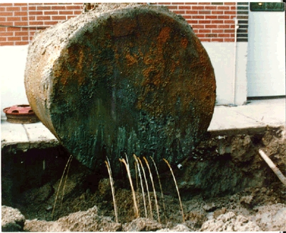
Underground Storage Tank Program HB 2636
Laura Malone
Director, Waste Programs Division

Slide 2
NEW ADEQ UST/LUST PROGRAM - BACKGROUND
SUMMARY OF UST PROGRAM HISTORY:
1986 – UST Release Prevention Program and Leaking UST (LUST) Program (to oversee release cleanups) were created
1989 – January 1989 is first compliance deadline for Federal Financial Responsibility (FR) requirements. In 1989, FR requirements were added to AZ UST Statutes
1990 – UST Revolving Fund is established.
The fund has 3 accounts:
Regulatory Account
Assurance Account [State Assurance Fund (SAF)]
Loan Account (approx. 20,000 USTs and approx. 1,500 open releases)
Notes:
The SAF was established in 1990 to pay for ADEQ oversight of UST release cleanups and to assist owners and operators with the potentially high cost of cleanup. It functioned as a partial financial assurance mechanism intended to assist owners or operators in meeting new FR requirements.

Slide 3
NEW ADEQ UST/LUST PROGRAM - BACKGROUND
SUMMARY OF UST PROGRAM HISTORY:
1998 – Deadline for UST upgrade requirements
2004 – SB 1306 sets forth phase out dates for SAF coverage (approx. 8,000 USTs and 2,300 open releases)
2005 – Federal Energy Policy Act passes
2006 – End of SAF eligibility for releases reported after June 30, 2006 (approx. 1,500 open releases)
2010 – End of SAF claim eligibility: no claims accepted after June 30, 2010 (approx. 7,000 USTs and 860 open releases) total SAF payout: approx. $335M

Slide 4
NEW ADEQ UST/LUST PROGRAM - BACKGROUND
CURRENT CONDITIONS:
Open LUSTs (data from 6/16/2015): 707 at 389 facilities
92% of reported releases have been closed
fewer releases are being reported from upgraded UST systems
USTs (Open and in Temp. Closure): approx. 6,558
SAF paid out approx. $335M in claims for corrective actions at approx. 2,600 facilities.
SAF paid out approx. $65M for State Lead cleanups.
State Lead corrective actions are currently funded through the Regulated Substance Fund (RSF) – will move to new fund

Slide 5
NEW ADEQ UST/LUST PROGRAM - BACKGROUND
THE STATE ASSURANCE FUND:
The phase-out of the SAF program included increased outreach efforts to owners and operators regarding FR requirements.
The phase-out addressed release reporting timeframes and claim submittal deadlines for eligible releases :
Deadline for release reporting for SAF eligible releases
– June 30, 2006
Deadline for claim submittal for eligible releases
– June 30, 2010
Notes:
SAF was never established to be a complete FR mechanism (only $500M in coverage and NO third-party coverage – federal requirements include 3rd party and, typically $1M in minimum coverage)
Under SB 1306, SAF was made primary with increased focus on ensuring that O/Os understood their responsibility to have complete FR coverage.
O/Os confirmed releases prior to June 30, 2006 (spike in previous chart) and submitted claims
*ADEQ remains willing to discuss options that may be available for O/Os who aggressively conducted cleanup activities and through no fault of their own were unable to achieve closure prior to the claim submittal deadline.
**O/Os who are technically and/or financially incapable continued to be eligible to apply to the State Lead Program to help with their cleanup.
Many previous SAF volunteers and small O/Os (who could not afford their cleanup costs) transitioned from SAF claims process to State Lead.
NOTE - From the September 2013 Sunset Factor Auditor’s report:
After implementing changes identified through the lean process, the number of State Lead sites increased from 63 in FY12 to 103 in FY13
(FY11 – 51 sites)
- “sites” equals facilities (which may have multiple releases) not releases
Stakeholders and USTPC supported phase out of the SAF -
also noted in previous slide:
from USTPC meeting minutes – March 24, 2004: USTPC financial subcommittee (chaired by Andrea Martincic, APMA) sent out insurance surveys and made 3 recommendations:
1 – make SAF primary mechanism for first $500k
2 – support fixed dates for SAF eligibility phase-out and deadlines for submitting claims to that work
3 – phase out of SAF tax must include language to insure payment of SA liabilities incurred at the time of last application submittal date
In the same meeting minutes, Andrea (APMA) stated that O/Os were aware of requirements to meet FR and, that SAF, even if made primary for $500k did not meet FR requirements
*interestingly: SB 1306 passed in 2004. SAF payouts from 2004 (which should reflect activities conducted mostly from 2003 through 2004 when phase out was being discussed) to end of payments (work done through June 2010) = $144M (approx. 43% of the total $335M payout)

Slide 6
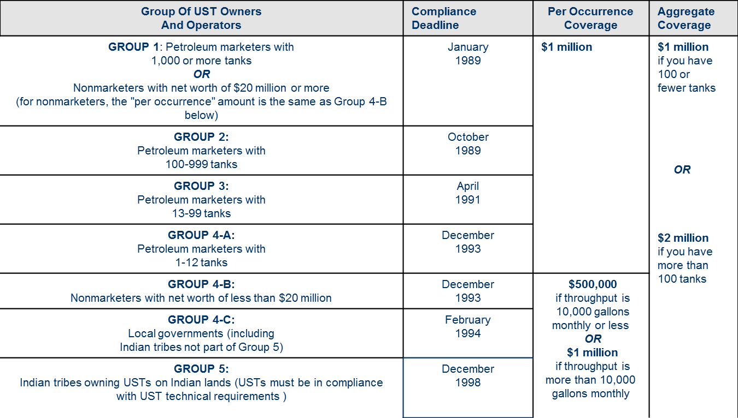
NEW ADEQ UST/LUST PROGRAM - FINANCIAL RESPONSIBILITY REQUIREMENTS
Review of Federal FR Requirements

Slide 7
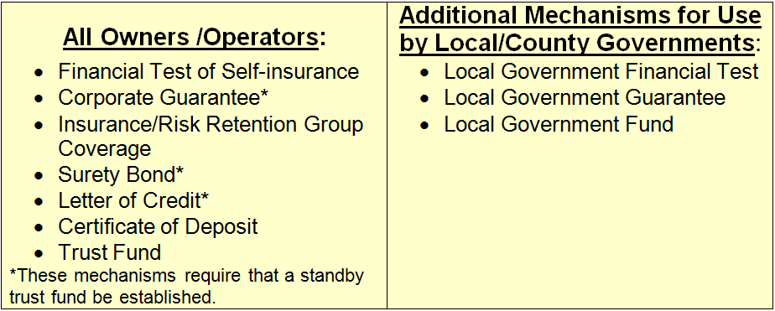
NEW ADEQ UST/LUST PROGRAM - FINANCIAL RESPONSIBILITY REQUIREMENTS
Allowable Arizona FR Mechanisms
A large number of options are available to owners/operators to demonstrate that they comply with FR requirements. In Arizona the allowable financial assurance mechanisms are as follows:
Owners/operators may use one mechanism or a combination of mechanisms to meet FR obligations.

Slide 8
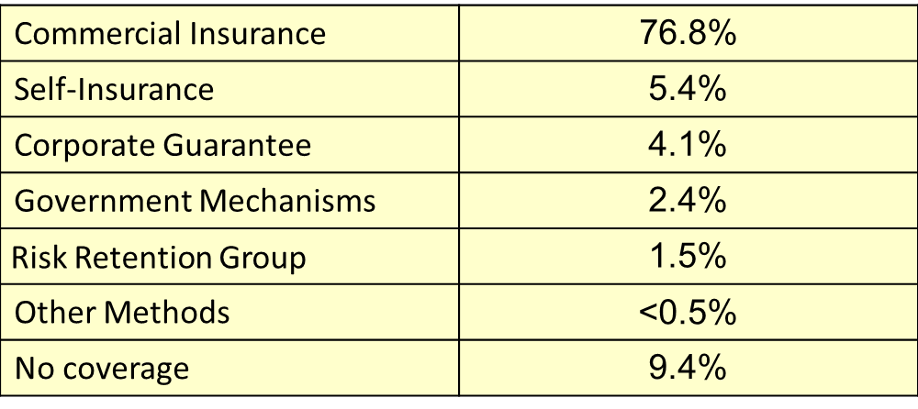
NEW ADEQ UST/LUST PROGRAM -FINANCIAL RESPONSIBILITY REQUIREMENTS
FR Mechanisms in Use in Arizona
(NOTE: percentages are approximate)

Slide 9
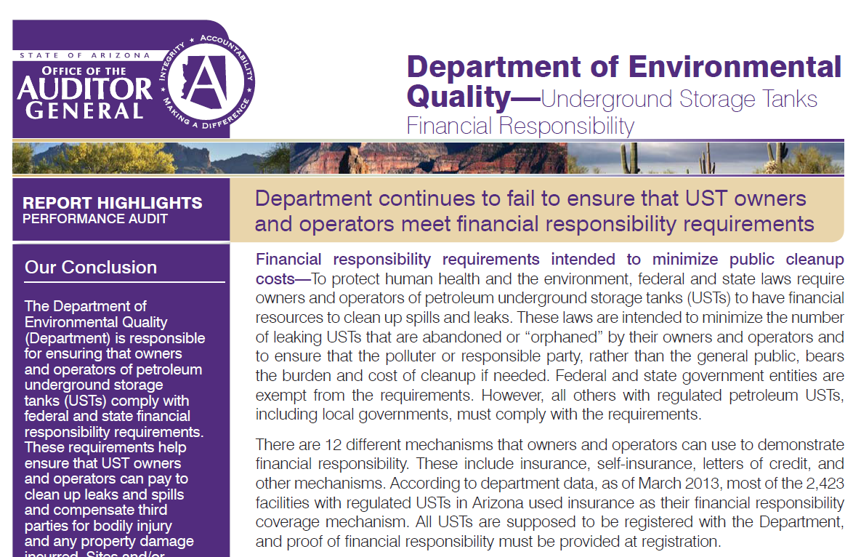
NEW ADEQ UST/LUST PROGRAM - BACKGROUND
In response to the 2013 UST FR Performance Audit, ADEQ is making changes to FR processing, data tracking, outreach, and training
Notes:
*SAF did not meet FR requirements which is why it was only approved by EPA in 1994 as a partial mechanism
SAF provided up to $500k for corrective action costs (only) NO 3rd party coverage
FR requirements are designed to ensure that, in the event of a leak or spill, the UST owner or operator will have the resources to pay for costs associated with cleaning up releases and compensating third parties.
FR requires $1M per occurrence in corrective action coverage AND 3rd party compensation for sudden AND non-sudden accidental releases
(and, must exclude legal defense costs from required amount of coverage)
Note – per occurrence coverage is only $500k if monthly throughput is 10,000 gallons of less
ADEQ commits to continuing efforts to make improvements. Outreach for FR requirements has been a primary concern for the agency since 1996 (discussions from UST Policy Commission and stakeholder groups detail this effort). More focused efforts took place after SB1306.

Slide 10
NEW ADEQ UST/LUST PROGRAM - FINANCIAL RESPONSIBILITY REQUIREMENTS
ADEQ FR Documentation Requirements
Documentation showing compliance with FR requirements must be submitted to ADEQ on an annual basis.
All documentation must include the schedule of covered tanks
Insurance policy:
The endorsement or certificate (whichever is applicable) must be worded as specified in 40 CFR §280.97
NOTE: ACORDS, Declarations and Binders are NOT acceptable documentation (proof) of FR compliance

Slide 11
Underground Storage Tank (UST) Program
Why a new program
ADEQ’s mission is to protect and enhance public health and the environment
Challenges with insurance coverage
Shear number of tanks reaching end of life
Number of small owners/operators (O/Os)
Payment for time-barred claims

Slide 12
Underground Storage Tank (UST) Program
New UST Program – Not the old State Assurance Fund (SAF)
Focused on uniting UST owners, UST vendors, UST insurance providers, and ADEQ in our efforts to responsibly identify and cleanup petroleum contaminated properties impacted by releases from regulated UST systems.
Intent is to provide UST owners and operators who are in compliance with financial responsibility (FR) requirements the technical support and financial assistance to quickly address releases.
New Program is not Financial Assurance
New requirements for insurers
Provides a mechanism for reimbursement of previously time-barred claims
Red tag authority for non-payment of tank fees
Repeals the one cent per gallon excise tax on regulated substances on January 1, 2024
Requires 30-day notice to ADEQ at least 30 days before bringing tanks into operation

Slide 13
Provisions: Insurance
Two year insurance review (effective January 1, 2016)
Claims denied - Owner/Operator (O/O) required to provide ADEQ with a copy of the notice within 30 days after date of termination or nonrenewal of insurance
Retro dates (effective January 1, 2017, or on insurance renewal date - whichever is earlier)
Date of most recent baseline assessment or site characterization as determined by ADEQ
UST installation date
Earliest retroactive coverage date of previous insurance policy or alternative FR mechanism
ADEQ to assist O/O in pursuing claim against FR mechanism and obtaining coverage for a confirmed release
Notes:
Limits cost sharing eligibility to:
The limits prescribed;
The preapproval process; and
Providing timely notice of the release to the insurance carrier

Slide 14
Provisions: Insurance
Cost sharing for O/Os that satisfy FR through means other than insurance
50K per facility for work beginning January 1, 2016.
Eligibility terminates on the date insurer is obligated to provide payment under the policy – policies in effect on April 15, 2015
O/O required to file and pursue insurance claim until a denial is received or ADEQ determines the claim has been constructively denied – O/O not required to exhaust insurance coverage before they are eligible for the fund
Bars eligibility for corrective action and reimbursement for failure to pursue an insurance claim

Slide 15
Baseline Assessment
Establishes seven-year baseline assessment period beginning Jan 1, 2016, for UST O/Os who meet requirements and may:
Elect to conduct a baseline
Request a grant to cover baseline assessments
Request ADEQ to perform the baseline assessment
ADEQ to establish standards for conducting baseline assessments
Must be conducted by registered professional engineer, registered geologist or licensed remediation specialist
Scope must address likely release areas and include a collection of sufficient information to allow for a determination of the current environmental condition of the property
Samples must be collected in areas where contamination is most likely to have occurred; and consider site-specific conditions and location of potential receptors and preexisting contamination
Baseline assessment work plans must be submitted to ADEQ for approval and be considered on a case-by-case basis until rule or guidance documents are established
Notes:
Bullet 5: Samples must:
Bullet 6: If unknown contamination is identified in the baseline assessment all of the following apply:
O/O must comply with the reporting requirements and initiate corrective action;
Unless documentation is provided that demonstrates the operating UST is not the source of release, ADEQ must require tightness testing; and
If continued operation of the UST may result in continued release, ADEQ may initiate delivery prohibition

Slide 16
Preapproval Process
Preapproval process required to be eligible for reimbursement from the UST Revolving Fund (Fund) for corrective actions taken
Precludes reimbursement for activities completed before ADEQ approval of the scope of work beginning Jan 1, 2016
Change notice(s) required if preapproved scope of work cannot be implemented as approved
Requires determination of whether the O/O was a small owner at the time of application
Prioritizes corrective action reimbursement applications for small owners based on several guidelines
Prioritizes reimbursement for all other owners that are eligible for Fund reimbursement based on the work completion date

Slide 17
Reimbursement of Corrective Action
Failure to submit a timely reimbursement request under a preapproved scope of work deems claim as denied.
Requires ADEQ or designated contractor to preapprove reimbursement of corrective actions
Mandatory kick-off meeting – purpose is to establish a clear understanding of objectives , expectations, roles and responsibilities.
Priority to small owners (less than 20 facilities)
Notes:
Bullet 3: Allows ADEQ to provide reimbursement under preapproved scope of work for feasible costs of C/A relating to:
Soil remediation;
Groundwater remediation; and
Corrective actions related to control and removal of source contamination
Bullet 4: Requires ADEQ or designated contractor to preapprove reimbursement of C/A costs for:
Small owners by encumbering monies for that year in the annual C/A allocation and provide reimbursement upon completion of the C/A for which monies were encumbered; or
Non small owners without encumbering monies and provide reimbursement based on the completion date of the C/A

Slide 18
Extent of Reimbursement
Allows reimbursement for reasonable and necessary costs of eligible activities for releases reported before the end of the baseline period.
Per facility versus per occurrence – 1 Million cap
Requires:
Costs for C/A to be submitted as prescribed; and
Payment only for C/A that have been completed and conducted according to the preapproval approved by ADEQ
Receipt of financial assistance from the Fund does not constitute a financial assurance mechanism and may not be used to demonstrate compliance with FR requirements or provide compensation to third parties for bodily injury or property damage.

Slide 19
Termination of Eligibility
Beginning January 1, 2023, only those releases of a regulated substance reported before January 1, 2023 are eligible for C/A cost reimbursement from the Fund
Requires:
An application for preapproval to be filed with ADEQ no later than 5pm on December 31, 2029; and
An application for reimbursement of eligible costs from the Fund to be filed with ADEQ no later than 5pm on December 31, 2030.
Any application or expense incurred after December 31, 2030 from eligibility for reimbursement from the Fund and declares all claims extinguished.

Slide 20
Noncorrective Actions
Permits an owner, operator or volunteer to request that ADEQ conduct one or more of the following noncorrective actions at a site:
Baseline assessment;
Confirmation of a suspected release; or
Permanent closure of a UST
Permits the Director to consider the following factors to determine priority for requests:
The age, construction and operational history of the UST site;
The hydrogeologic characters of the UST site and surrounding area;
The proximity, quality and current and future uses of nearby surface water and groundwater;
The potential effects of residual contamination on nearby surface water and groundwater
The degree of exposure; and
The financial responsibility of the person to conduct the action with their own monies.

Slide 21
Grant Priority
Allows an O/O or volunteer to request ADEQ provide monies to conduct one or more of the following (up to max of $100K per site, rather than per owner)
Removal of USTs (permanent closure) – up to $20K/tank
Confirming a suspected release (tank/site) – up to $10K
Baseline Assessment of a site, up to $30K
Permits the Director to consider several factors in determining priority for requests
Prohibits grant monies for work that takes place more than one year after the approval date
Notes:
Allows an O/O or volunteer to request ADEQ provide monies to conduct one or more of the following (up to max of $100K per site, rather than per owner):
Actions necessary to ensure the UST, its piping and under-dispense containment comply with standards for new installation, including replacement of components, up to a max of $100K
Removal of USTs for the purpose of permanent closure or replacement, up to a max of $20K per tank;
Confirmation of a suspected release at a tank or site, up to a max of $10K; and
Obtaining a baseline assessment of a site, up to a max of $30K
Permits the Director to consider the following factors in determining priority for requests:
The age, construction and operational history of the UST;
The hydrogeologic characters of the UST site and surrounding area
The proximity, quality and current and future uses of nearby surface water and groundwater;
The potential effects of residual contamination on nearby surface water and groundwater;
The degree of exposure; and
The financial resources of the applicant
Requires a request for grant monies to include:
Detailed information about the site including type, number and location of tanks;
Information about the owner and operator, including the type of FR;
A description of the evidence of any release or suspected release; and
The proposed actions necessary to meet tank and system performance standards

Slide 22
Previously Time-Barred Claims
Reimbursement for releases of regulated substance that were properly reported before July 1, 2006, and July 1, 2006 through January 1, 2016 (Gap and Post-Gap claims)
Up to $500K per facility for an applicant who satisfies FR through an alternative mechanism; and up to $1M per facility for an applicant who satisfies FR through insurance
Reduces reimbursement by the amount paid for claims at a facility before June 30, 2010
Reimbursement based on percentage of each claim to be paid with available funds
Application for reimbursement of C/A cost requirements
Notes:
Bullet 3: Limits reimbursement:
Up to $500K per facility for an applicant who satisfies the FR obligations through a financial assurance mechanism other than insurance; and
Up to $1M per facility for an applicant who satisfies the FR obligations through insurance
Bullet 5: Requires ADEQ to:
Determine the percentage of each claim to be paid based on available Fund monies;
Pay all compensable claims in equal proportion based on claim amount, if timely submitted; and
Provide reimbursement for 90 percent of reasonable and actual costs incurred
Bullet 6: Requires an application for reimbursement of C/A costs to:
Document costs by facility;
Include a signed declaration affirming the submitted costs are true, accurate and have not been reimbursed by insurance or an alternative financial assurance mechanism;
Be submitted by December 31, 2016
Bullet 8: Precludes the following from eligibility for reimbursement:
An insurance or alternative financial assurance mechanism provider that is not an owner or operator with respect to that facility; and
An owner or operator not in compliance with the FR obligations

Slide 23
Previously Time-Barred Claims
ADEQ not required to take any action on a reimbursement application until January 1, 2017
If reimbursement was exhausted through claims submitted by June 30, 2010, that facility is not eligible for any additional reimbursement
ADEQ to determine the amount of SAF monies available on December 31, 2016, to pay claims
ADEQ is not required to evaluate and issue payments more than once per year beginning 2017

Slide 24
Fund
Restructures the Underground Storage Tank Revolving Fund Permits Fund monies to be used for specific uses
Requires performance standards and contractual penalties for nonperformance/inadequate performance in any awarded contracts
Requires ADEQ to reimburse the Fund for any corrective or noncorrective action costs paid from the Fund that are subsequently recovered
Notes:
Permits Fund monies to be used:
For reasonable and necessary costs in taking noncorrective actions;
For recovering expenses of noncorrective actions;
To provide reimbursement for eligible costs; and
To reimburse ADEQ for reasonable and necessary costs incurred in administering the C/A requirements and the UST Grant Program

Slide 25
Miscellaneous
Eliminates the UST Policy Commission and Technical Appeals Panel
Stipulates that an application for preapproval, reimbursement, C/A and noncorrective action must be on a form provided by ADEQ and contain sufficient information to allow ADEQ to make a determination of priority for that request
Requires ADEQ to submit a report on the Fund Program by Dec 31, 2017, and every three years thereafter
Provides administrative caps and distribution of Fund monies in FY 2016
Notes:
Bullet 6: Requires ADEQ to submit a report on the Fund Program by Dec 31, 2017, and every three years thereafter containing:
Fund financial information;
The amount of any remaining unpaid time-barred claims;
A description of work completed for each Grant program component;
The amount of Fund reimbursements made annually;
A listing of new releases reported, sites closed and liabilities;
A description of state-led corrective actions; and
The total number of open and closed releases, reimbursement application denials and preapproval appeals
Bullet 10: Repeals the following:
SAF;
Regulated Substances Fund;
The Grant Account;
Underground Storage Tank Policy Commission; and
Underground Storage Tank Technical Appeals Panel

Slide 26
There’s A Lot of Work To Do…………
Effective July 3, 2015
Grant program (except baselines)
30 day notice to bring tank into operation
Notice to ADEQ of insurance denial or termination
O/O can request ADEQ’s State Lead program to manage corrective actions or non-corrective actions (except baselines)
Red tag authority for non-payment of tank fees
Submittal of work plan for preapproval, reimbursement

Slide 27
There’s A Lot of Work To Do…………
Effective January 1, 2016
Notification requirement on insurance denials, non-renewal
Baseline assessment period begins (7 years)
Pre-approval for corrective action costs
Effective December 31, 2016
Deadline to submit time-barred claims

Slide 28
Status of July 3rd Actions
Updated ADEQ webpage that includes:
Preapproval application
Grant application
State Lead
Corrective Action
Non-corrective action

Slide 29
What should you do?
First, be Patient!
Stakeholder involvement needed
For time barred claims:
Schedule a meeting with ADEQ to review current status of the site and availability of funds for reimbursement

