Slide 1
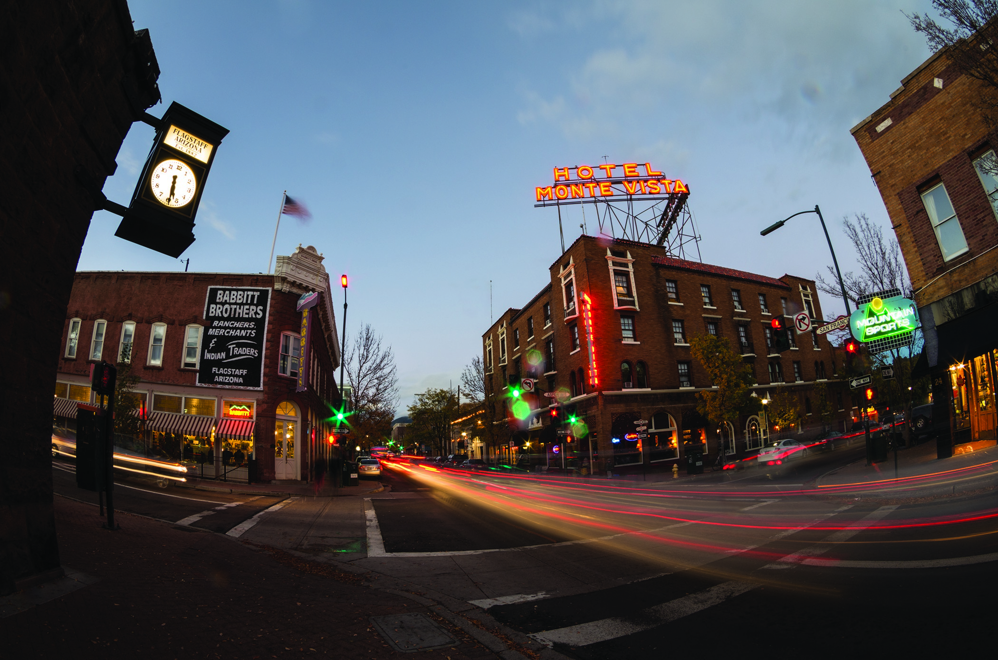
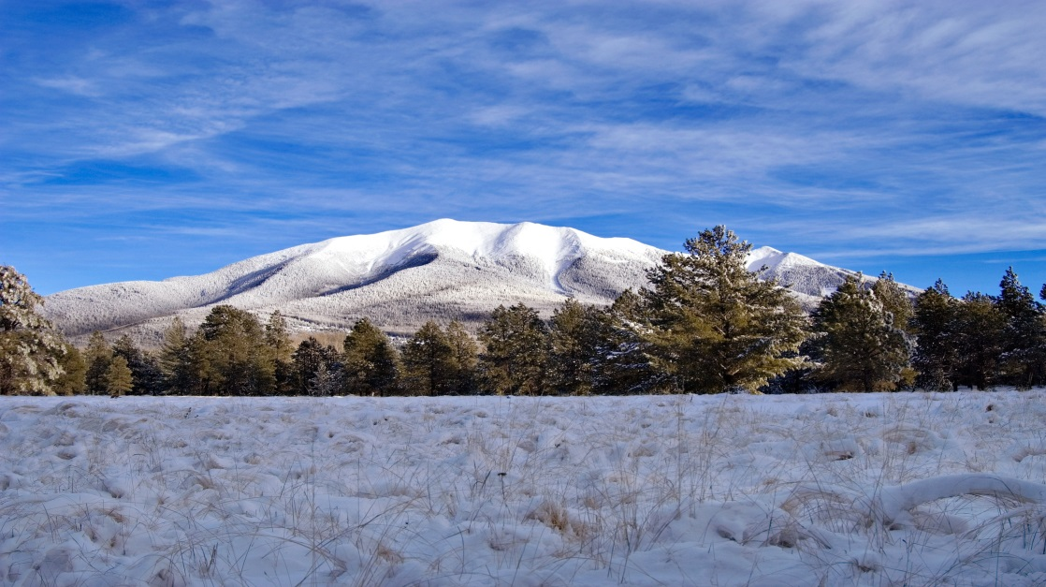
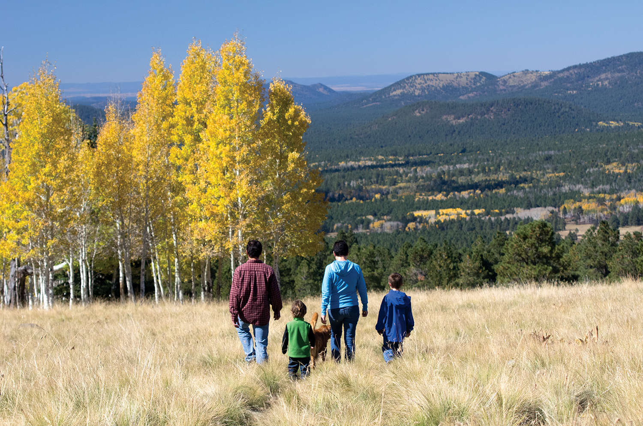
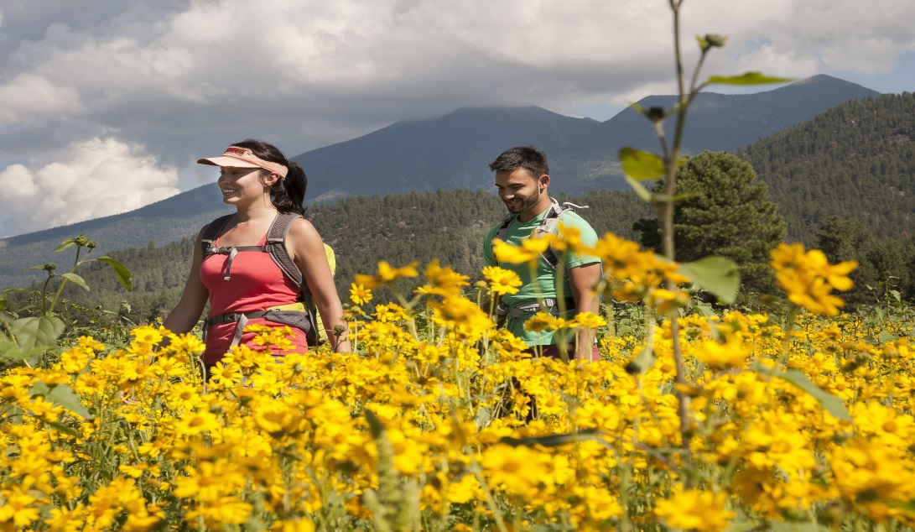
Flagstaff Convention and Visitors Bureau
Tourism Marketing

Slide 2
TOURISM MARKETING
What Is Tourism Marketing?
TOURISM occurs when you leave your normal surroundings where you live and work to go to another environment to engage in activities there, regardless of how close or how far it is. YOU ARE A VISITOR, and what you do while visiting is tourism. Individuals and organizations at your destination promoted those activities through advertising or other forms of marketing.
Tourism Marketing Plan
Every marketing effort should begin with a plan.
The marketing plan is your road map which details how you will reach your target audiences. It is also framed by your marketing budget. Your plan should have several collateral pieces such as a Visitor Guide to help promote area attractions, dining, and more.
At the end of each tourism season, you can use your marketing plan to set goals and make changes for next year dependent on your ROI (return on investment).

Slide 3
Flagstaff CVB & Visitor Center Goals
CVB:
Increase visitation and extend the length of stay by positioning Flagstaff as the premier year-round destination from which travelers can explore and experience all that Northern Arizona has to offer.
VISITOR CENTER:
Encourage visitors to extend their stay in Flagstaff through enhanced customer service programs that inform, educate and motivate visitors to return.

Slide 4
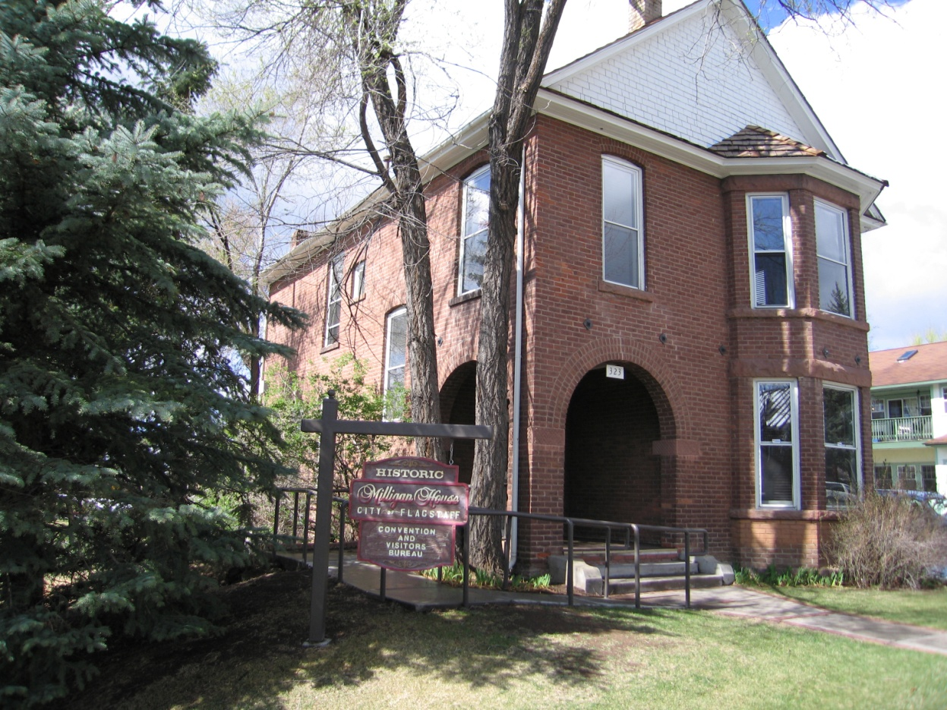
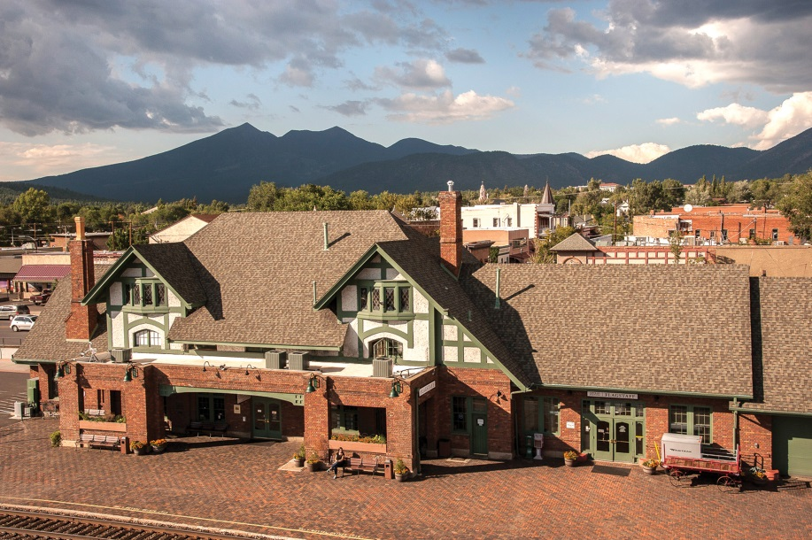
Flagstaff Convention and Visitors Bureau Flagstaff Visitor Center
1 East Route 66
323 W. Aspen Avenue

Slide 5
CVB Program Areas,
Target Marketing, Media Plan
The CVB is made up of four program areas:
  Marketing
  Public Relations
  Sales
  Visitor Services
The CVB media plan is developed from the information we receive about our visitors
We market through:
  Print
  Digital/Web
  Email
  Press Releases
  Sales and Media Missions
  Event Sponsorships
  and More
Notes:
CLICK

Slide 6
Visitor Origin
Domestic
  Arizona (Greater Phoenix & Tucson) 33%
  California 14%
  Other U.S. States 36%
International
  Top 5 countries: 17%
  UK, Canada, Germany, Australia & France
  Flagstaff serves 4 million visitors
  per year on average

Slide 7
Tourism is Arizona’s top
export-oriented industry
$19.3 billion in direct spending annually
161,300 jobs created
Top
Export-Oriented Industry
Flagstaff Hospitality industry generates $390 million in direct annual spending and 5,400 jobs.
Bed, Board and Booze tax revenues collected help to drive our economy are $6.2 million.

Slide 8
Industry Measures
BBB Revenues – BBB tax is currently 2%.
The CVB receives 30% of the allocation with the remainder to:
Arts & Sciences 7.5%
Beautification 20%
Economic Development 9.5%
Recreation Programming 33%
RevPAR- Revenue per available room - # of hotel revenue / # of rooms available
ADR – Average Daily Rate - A measure of the average rate paid for rooms sold
Occupancy Figures – Leading the state in occupancy the past 4 years
Area Attractions – Keep a log on visitation to each area attraction
Per Party Expenditures – Average party size 3.2, spend $646/day, 2.6 nights, 60% families

Slide 9
Industry Measures – How we did…
2014 beat 2013 for Best Year on Record!
Occupancy:
70%, 5.4% increase over prior year
RevPar: (Revenue per available room)
$59.99, 9.9% increase over prior year
ADR: (Average Daily Rate)
$85.71, 4.2% increase over prior year
BBB:
8.38% increase year-to-date figures (thru Nov. ‘14)

Slide 10
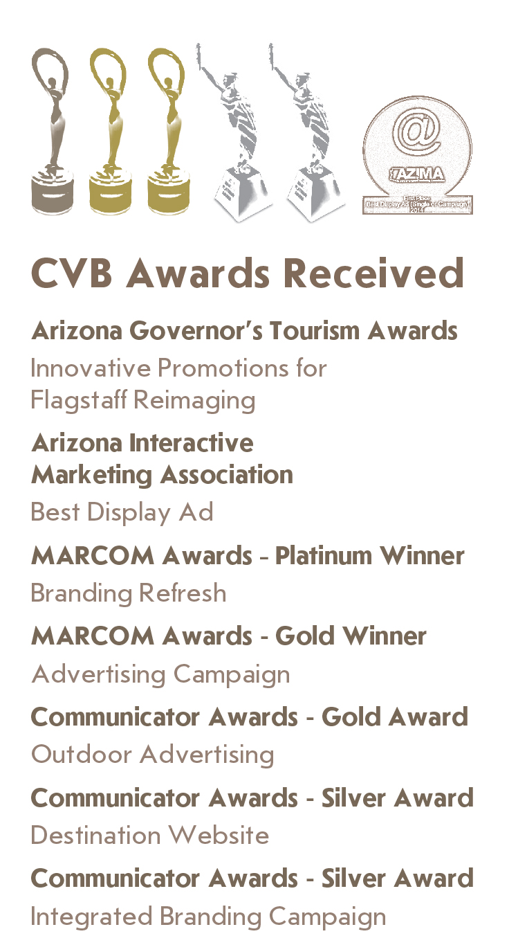


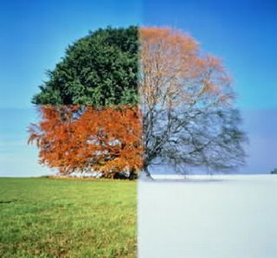
Launched our re-imaging campaign 2012
New logo, website, ads, & more
Successful – won 8 awards – including a City Manager’s Award of Excellence
Image is Everything
Everything changes with the seasons!

Slide 11
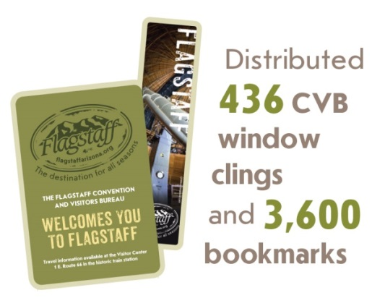
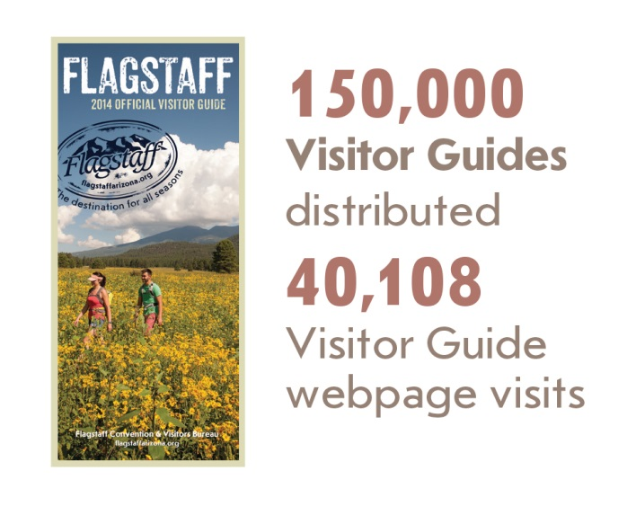
Branding Ideas

Slide 12

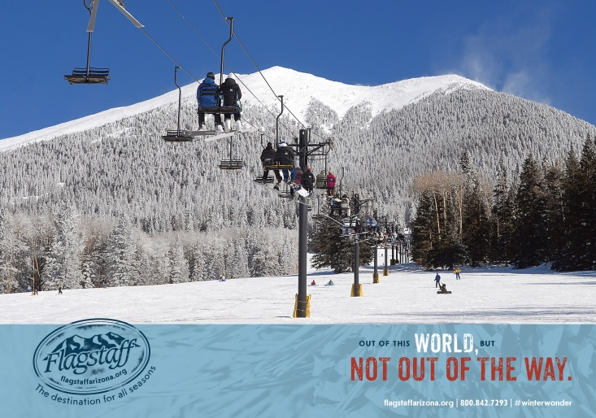
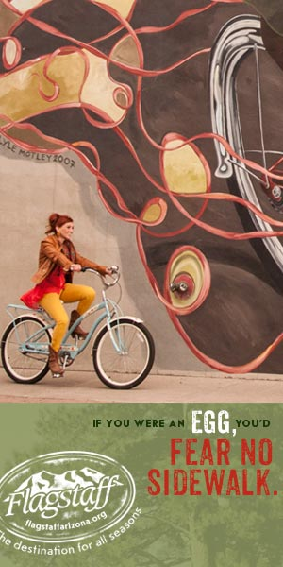
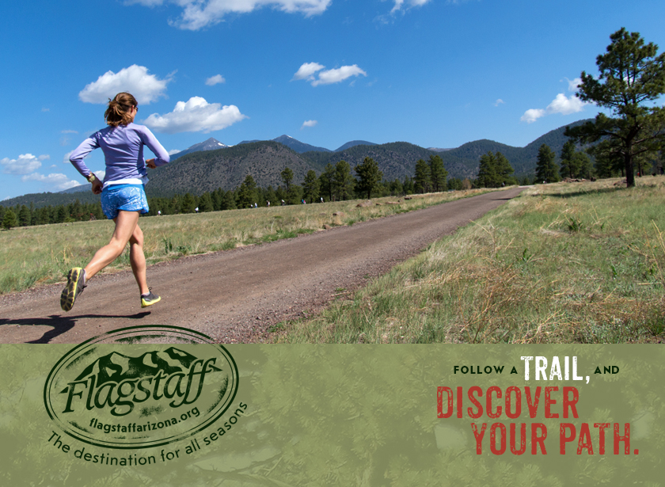
Photo Rich
Texture
Seasonality
Engaging Headlines

Slide 13
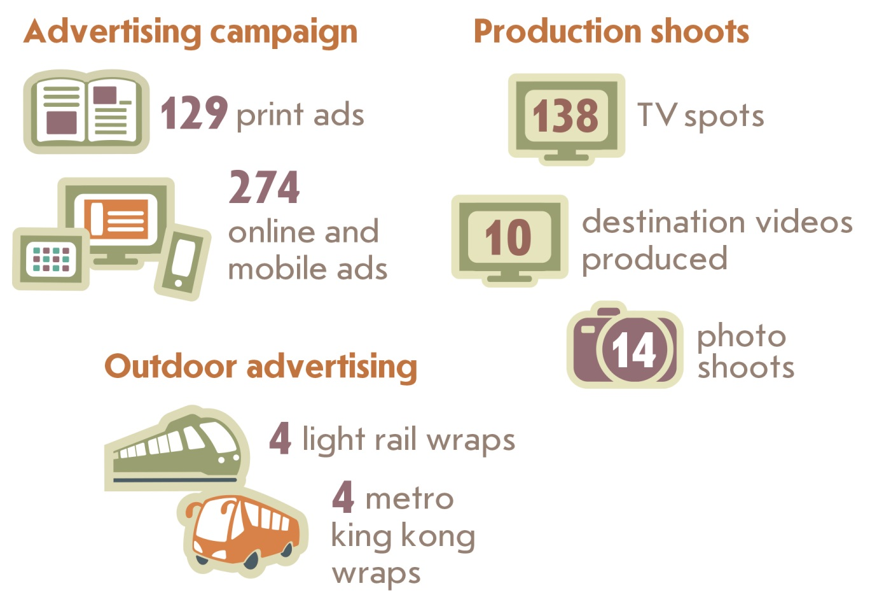
Marketing & Advertising

Slide 14
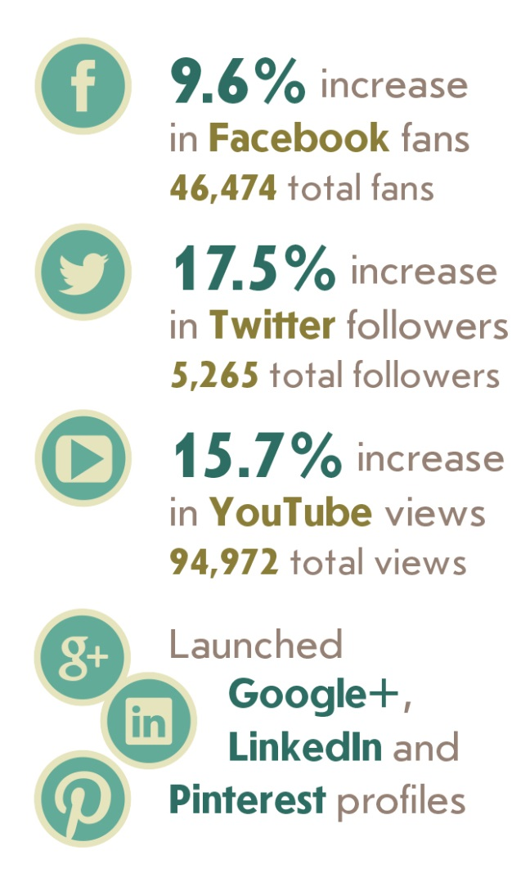
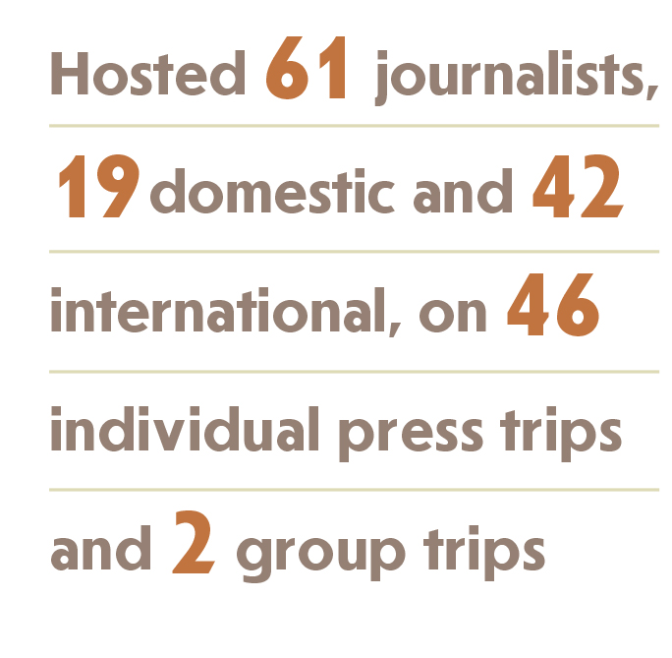
Public Relations & Social Media

Slide 15
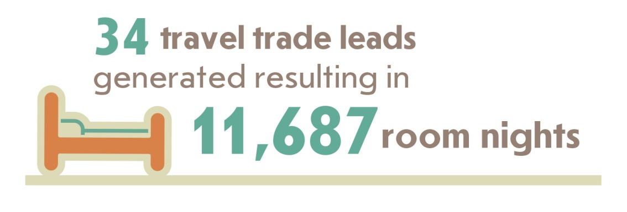
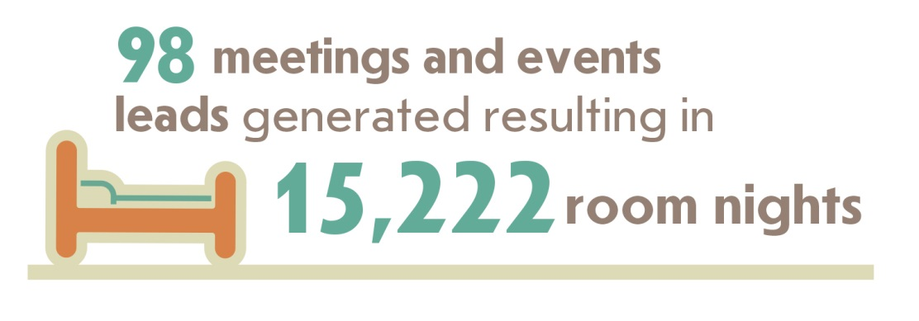
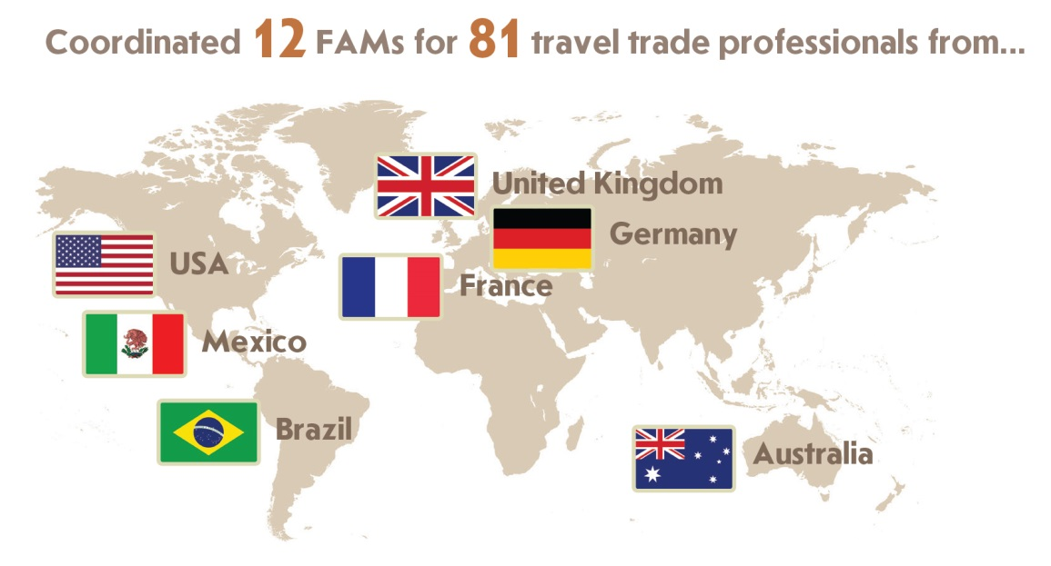
SALES
Travel Trade & Meetings/Events
  Assisted with 52 conferences including Cool Stars, Mustang Club Pony Drive, and NAU Merriam-Powell Center for Environmental research.

Slide 16
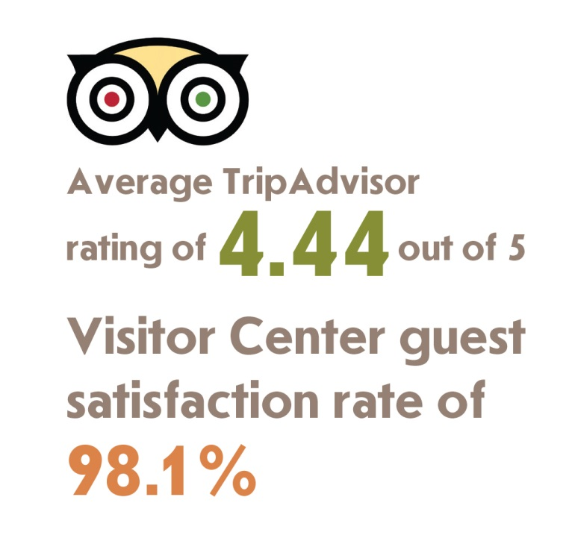
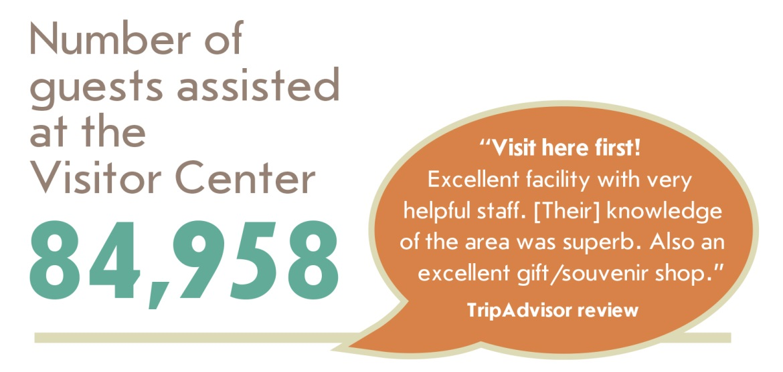
Visitor Services

Slide 17
Flagstaff Cool Zone

Slide 18
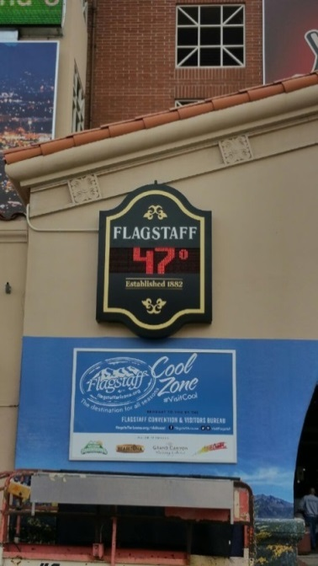
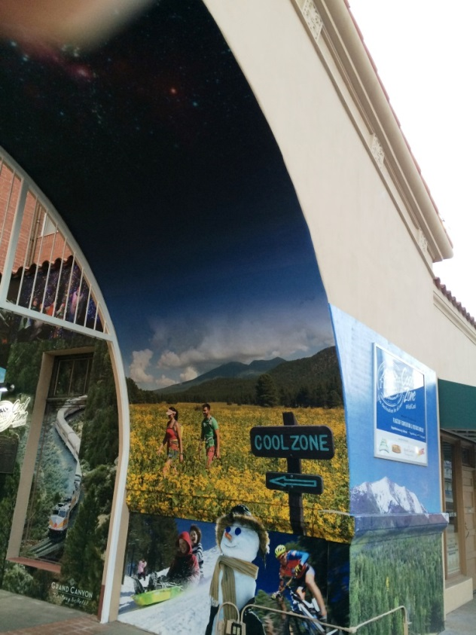
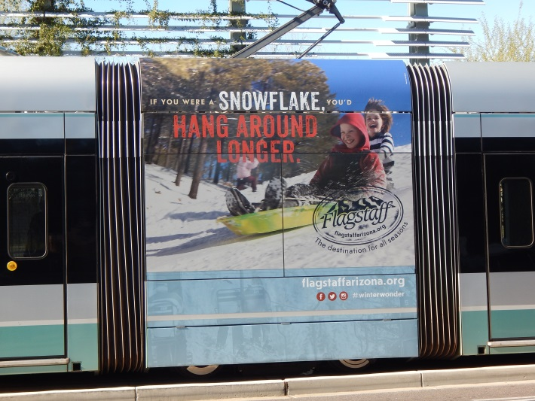
Flagstaff Cool Zone Updated

Slide 19

Amtrak Train Day:
Saturday, May 9th
10 – 3
Visitor Center

Slide 20
What can you do?
Invite your family and friends to visit Flagstaff.
Encourage visitors to extend their stay.
Hold your meetings and events in Flagstaff and encourage your colleagues to do the same.
Support area businesses by spending local.
Stop by the Flagstaff Visitor Center in the historic downtown train station at 1 E. Rt. 66 for travel information.
Save flagstaffarizona.org in your favorites!
Reach out to me with questions, issues, ideas.
  Heather Ainardi, Marketing & PR Manager
  213-2910 or hainardi@flagstaffaz.org

