Slide 1
APMA Safety training
Osha hazardous communication standard

Slide 2
Background/why are we talking about this???
1983 – OSHA Adopted Hazardous Communication Standard
AKA Employee Right to Know
No specific label format
2012 – OSHA Revised Standard
Requires container labels in specific format with standardized hazard classification system
GHS labeling requirements– Globally Harmonized System
Requires Safety Data Sheets to contain a 16 section format
Requires employee training
Notes:
HazCom started back in 1983. Idea was to protect Ees by giving them information about the chemicals they worked with. But since there wasn’t a standard label format, manufacturers used all sorts of different labels.
To make the standard effective (don’t ask me why it took 30 years to come to this conclusion), OSHA decided to revise the standard and adopt a uniform label requirement system. GHS – used internationally.
Also, need to train ees for this to be effective.

Slide 3
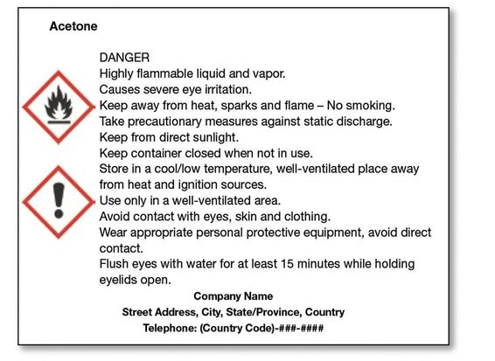
“GHS” labeling requirements
Identify the product or chemical
“Signal” Word (ie, danger or warning)
Hazard Statement
Precautionary Statements
How to prevent exposure
First Aid procedures
Spill response
Disposal of chemical
Supplier Information
Supplemental Info
Pictograms
Notes:
What does GHS require??
7 things
Supp info – expiration date or directions for use

Slide 4
Pictograms and hazards on Labels and sds’s
Flame Over Circle
Flame
Exploding Bomb
Skull and Crossbones
Corrosion
Gas Cylinder
Health Hazard
Environment
Exclamation Mark
Notes:
9 pictograms
Used on labels and Safety Data Sheets
Sometimes 2 or more per lable
- Still will see other labels when required by other agencies – DOT or EPA

Slide 5
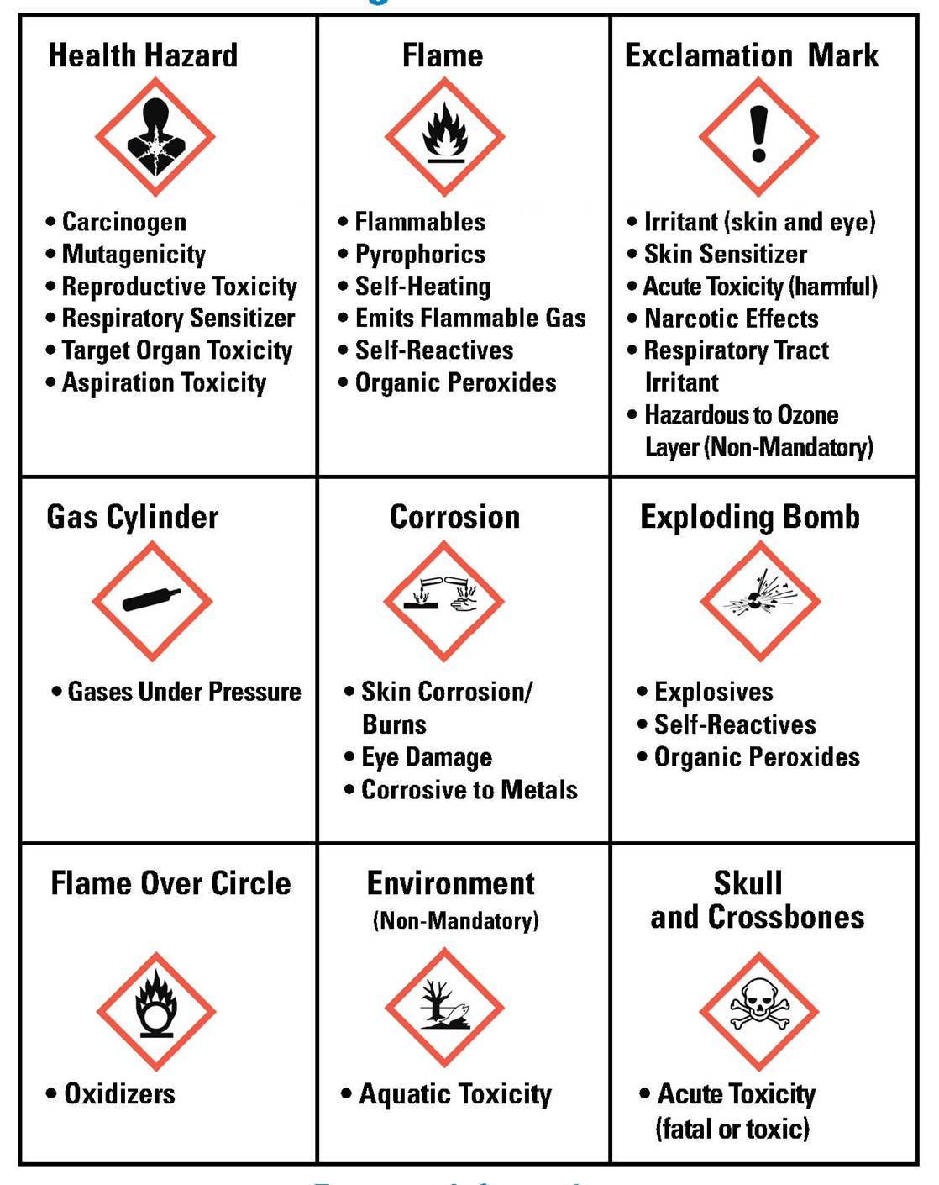
Notes:
This table details each of the 9 pictograms and when they should be used. I would go over this in depth when training employees.

Slide 6
Safety Data Sheet Requirements
Section 1 Identification
Section 2 Hazards(s) Identification
Section 3 Composition/information on ingredients
Section 4 First Aid measures
Section 5 Fire-fighting measures
Section 6 Accident release measures
Section 7 Handling and storage
Section 8 Exposure controls/personal protection
Section 9 Physical and chemical properties
Section 10 Stability and reactivity
Section 11 Toxicological information
Section 12 Ecological information
Section 13 Disposal Considerations
Section 14 Transport information
Section 15 Regulatory information
Section 16 Other information, including the date of preparation or last revision
Sections 12-15 must be consistent with GHS
Notes:
Safety Data Sheets must have these 16 sections
For sections 12-15, need to use the same information as GHS

Slide 7
Employer requirements
Update in house labeling systems to incorporate newly-required information
Train employees (by DECEMBER 1, 2013 so STAT) on new labeling system
OSHA Tutorial on youtube.com or oshatraining.com
Use GHS compliant labels by June 1, 2015
Update written HazCom programs by June 1, 2016
Notes:
What to do??
Update labeling
Train ees
keep a record of training
Use OSHA resources or these materials
By June 1, 2015, Use GHS compliant labels – many updating sooner
By June 1, 2016, update written Haz Com programs

Slide 8
Questions/comments??
Notes:
Questions?
Safety Cmte – what did I miss?
Remember to fill out the OSHA 300 log for 2013 by Feb. 1.

